Slide 1
Slash pine

Slide 2
Call:
lm(slashresidualssma ~ aridity * CN_SCALE +
MAT_bioclim + temp2, data = slashpine)
Residuals:
Min 1Q Median 3Q Max
-0.35729 -0.06458 0.00208 0.06848 0.46388
Coefficients:
Estimate Std. Error t value Pr(>|t|)
(Intercept) -1.282511 0.952228 -1.347 0.178166
aridity -0.625060 0.100780 -6.202 6.63e-10 ***
CN_SCALE -0.005157 0.001555 -3.316 0.000927 ***
MAT 0.180132 0.085428 2.109 0.035094 *
temp2 -0.004451 0.001988 -2.239 0.025280 *
aridity:CN_SCALE 0.006053 0.001719 3.521 0.000438 ***
---
Signif. codes: 0 ‘***’ 0.001 ‘**’ 0.01 ‘*’ 0.05 ‘.’ 0.1 ‘ ’ 1
Residual standard error: 0.09956 on 2210 degrees of freedom
(69 observations deleted due to missingness)
Multiple R-squared: 0.06518, Adjusted R-squared: 0.06306
F-statistic: 30.82 on 5 and 2210 DF, p-value: < 2.2e-16
logDIA ~ logAGEDIA, data = slashpine
Fit using Standardized Major Axis
------------------------------------------------------------
Coefficients:
elevation slope
estimate 0.1493704 0.5784213
lower limit 0.1215234 0.5599808
upper limit 0.1772174 0.5974689
H0 : variables uncorrelated
R-squared : 0.3765698
P-value : < 2.22e-16

Slide 3
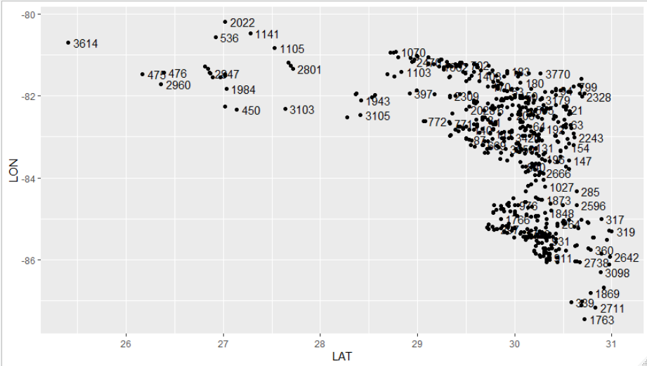
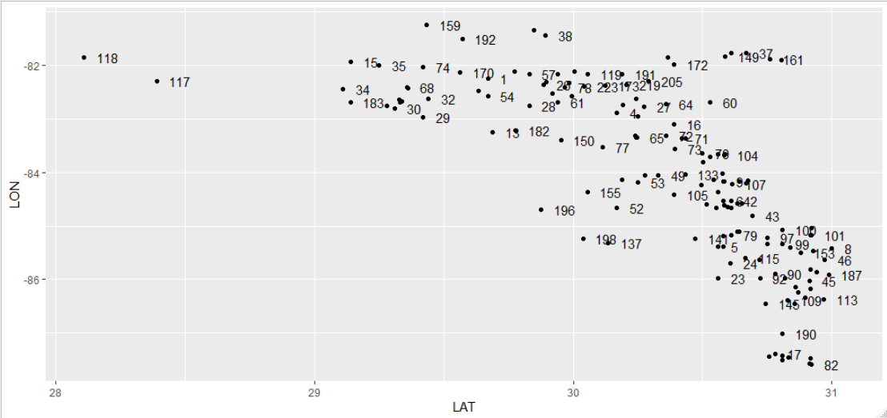

Slide 4
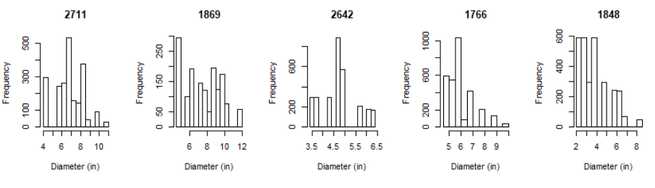
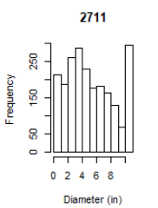
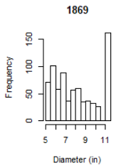
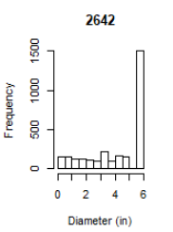
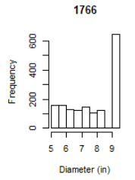
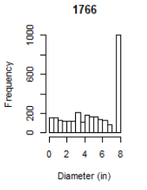

Slide 5
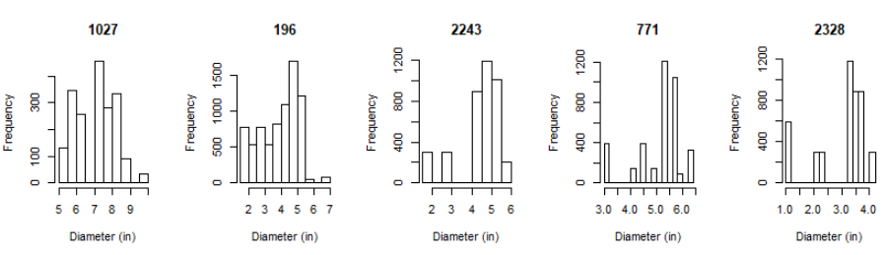
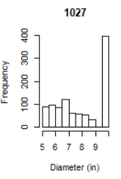
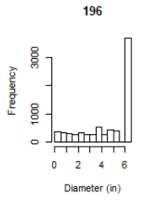
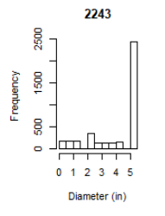
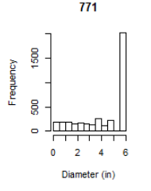
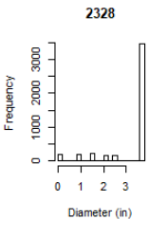

Slide 6
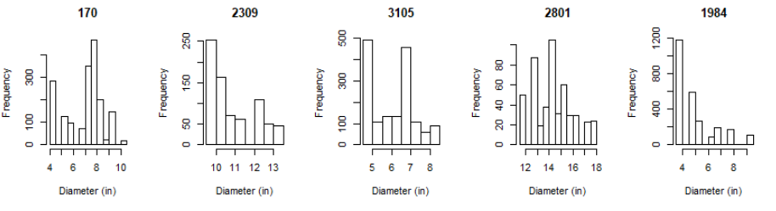
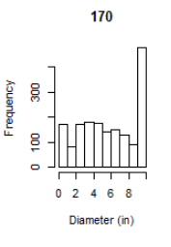
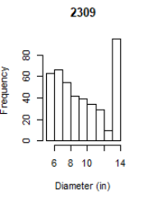
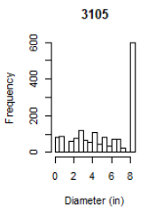
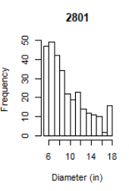
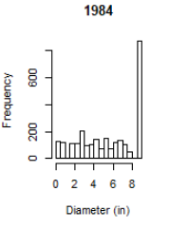

Slide 7
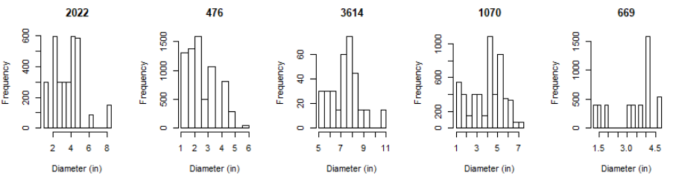
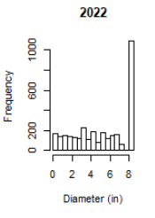
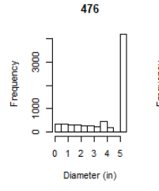
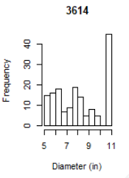
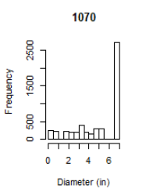
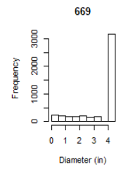

Slide 8
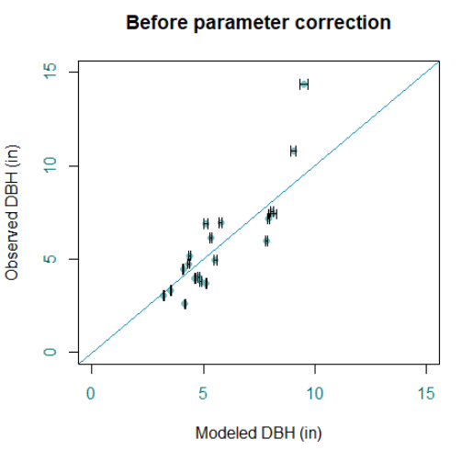
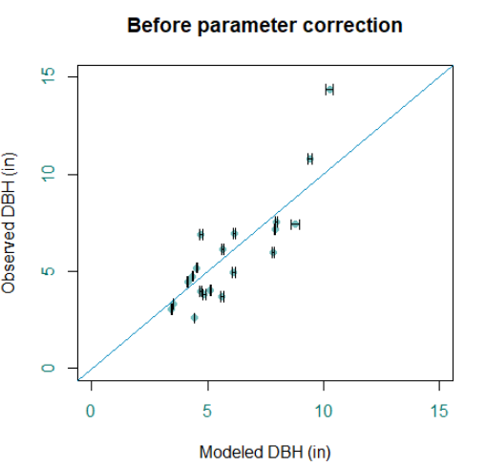

Slide 9
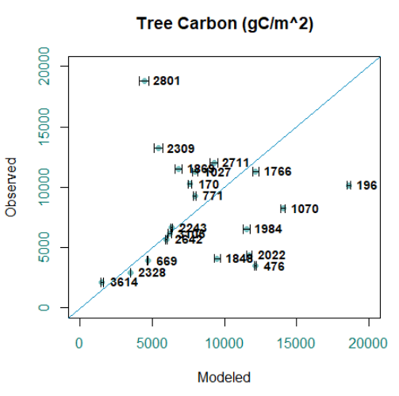
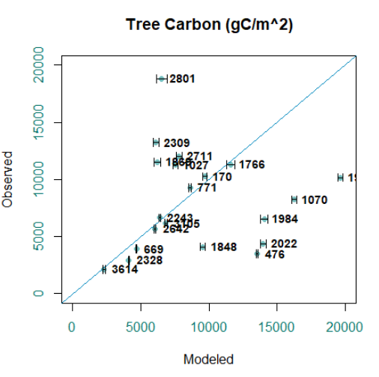

Slide 10
Call:
lm(formula = log10(Observed_Diameter/Modeled_Diameter) ~ Tree_Density +
Temperature, data = final_list)
Residuals:
Min 1Q Median 3Q Max
-0.12017 -0.04401 0.00813 0.04477 0.13808
Coefficients:
Estimate Std. Error t value Pr(>|t|)
(Intercept) 6.407e-01 2.394e-01 2.677 0.01594 *
Tree_Density -2.924e-05 9.239e-06 -3.165 0.00566 **
Temperature -2.769e-02 1.123e-02 -2.465 0.02464 *
---
Signif. codes: 0 ‘***’ 0.001 ‘**’ 0.01 ‘*’ 0.05 ‘.’ 0.1 ‘ ’ 1
Residual standard error: 0.07852 on 17 degrees of freedom
Multiple R-squared: 0.461, Adjusted R-squared: 0.3976
F-statistic: 7.27 on 2 and 17 DF, p-value: 0.005231
Call:
lm(formula = log10(Observed_Diameter/Modeled_Diameter) ~ Tree_Density,
data = final_list)
Residuals:
Min 1Q Median 3Q Max
-0.12481 -0.06965 0.02598 0.06000 0.12071
Coefficients:
Estimate Std. Error t value Pr(>|t|)
(Intercept) 7.165e-02 3.473e-02 2.063 0.0538 .
Tree_Density -2.701e-05 9.576e-06 -2.821 0.0113 *
---
Signif. codes: 0 ‘***’ 0.001 ‘**’ 0.01 ‘*’ 0.05 ‘.’ 0.1 ‘ ’ 1
Residual standard error: 0.08189 on 18 degrees of freedom
Multiple R-squared: 0.3065, Adjusted R-squared: 0.268
F-statistic: 7.956 on 1 and 18 DF, p-value: 0.01132 ‘***’ 0.001 ‘**’ 0.01 ‘*’ 0.05 ‘.’ 0.1 ‘ ’ 1 Residual standard error: 0.08189 on 18 degrees of freedom Multiple R-squared: 0.3065, Adjusted R-squared: 0.268 F-statistic: 7.956 on 1 and 18 DF, p-value: 0.01132

Slide 11
Longleaf pine

Slide 12
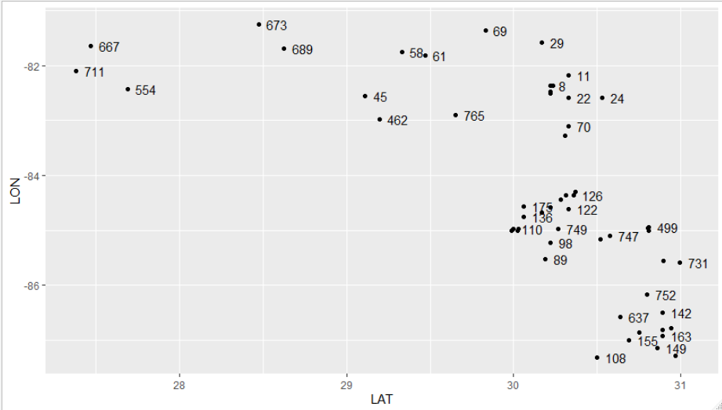

Slide 13
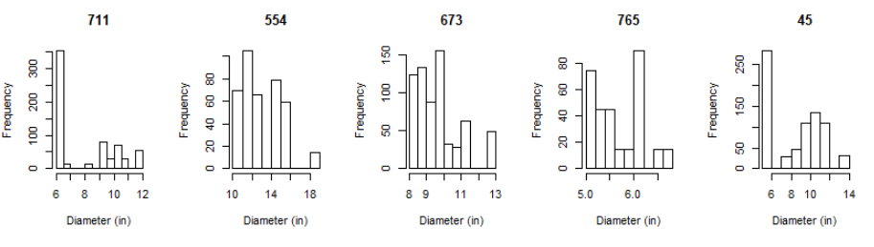
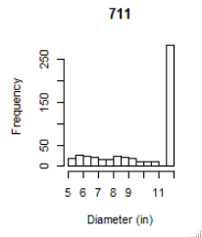
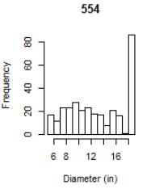
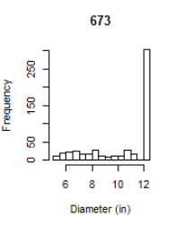
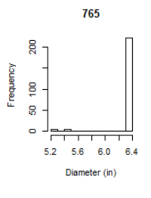
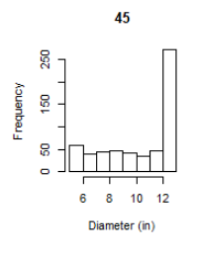

Slide 14
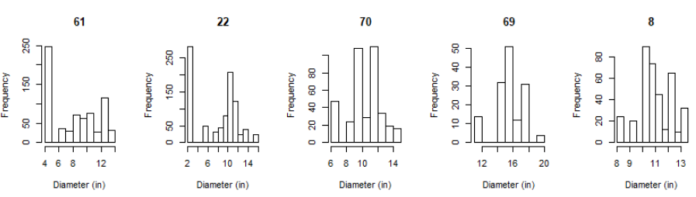
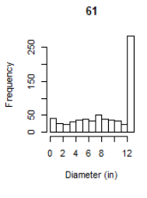
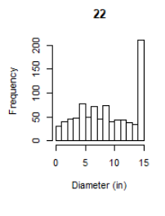
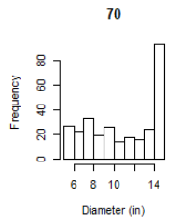
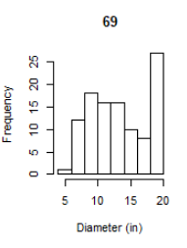
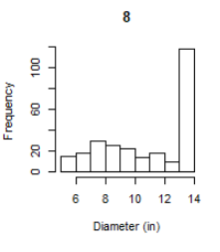

Slide 15
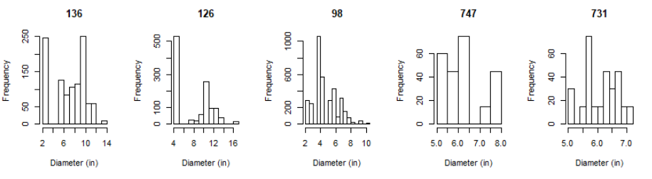
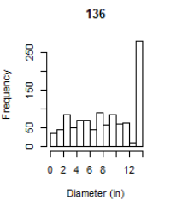
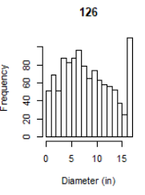
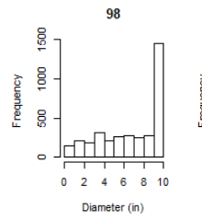
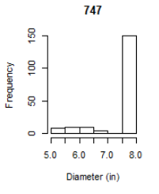
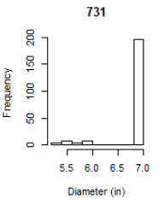

Slide 16
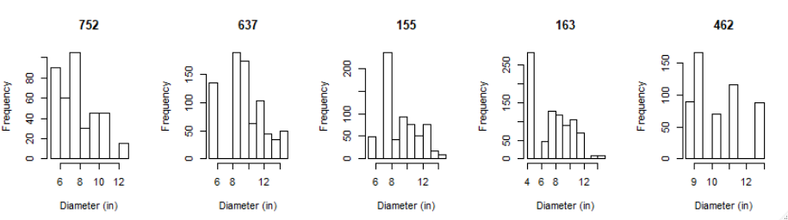






Slide 17


Slide 18
Call:
lm(formula = log10(Observed_Diameter/Modeled_Diameter) ~ log10(Age) +
Tree_Density, data = final_list)
Residuals:
Min 1Q Median 3Q Max
-0.091116 -0.019649 0.002529 0.027291 0.082152
Coefficients:
Estimate Std. Error t value Pr(>|t|)
(Intercept) -2.013e-01 7.914e-02 -2.544 0.02098 *
log10(Age) 1.116e-01 4.598e-02 2.426 0.02667 *
Tree_Density -4.574e-05 1.347e-05 -3.396 0.00344 **
---
Signif. codes: 0 ‘***’ 0.001 ‘**’ 0.01 ‘*’ 0.05 ‘.’ 0.1 ‘ ’ 1
Residual standard error: 0.04236 on 17 degrees of freedom
Multiple R-squared: 0.4799, Adjusted R-squared: 0.4188
F-statistic: 7.845 on 2 and 17 DF, p-value: 0.003858
10(0.9333 - 0.009259CN + 0.011340CN*aridity - 0.9775aridity) * 0.5719age^{-0.4281}
10(0.73 - 0.009CN + 0.011CN*aridity - 0.98aridity - .00046tph) * 0.6835age^{-0.3165}

Slide 19



Slide 20





Slide 21





Slide 22




Slide 23

TASB_Panhandle 7999.822 (+/- 279.7794)
TASB_North 11737.635 (+/- 491.0153)
TASB_Central 16176.855 (+/- 565.0578)
TASB_South 13673.639 (+/- 475.2070)

Slide 24
Loblolly Pine

Slide 25

(formula = logDIA ~ logAGEDIA, data = loblolly, method = "SMA")
Fit using Standardized Major Axis
------------------------------------------------------------
Coefficients:
elevation slope
estimate 0.002217684 0.7405648
lower limit -0.064798077 0.6945966
upper limit 0.069233446 0.7895752
H0 : variables uncorrelated
R-squared : 0.4149081
P-value : < 2.22e-16

Slide 26



Slide 27



Slide 28




Slide 29




Slide 30




Slide 31




Slide 32



Slide 33


With new mortality from loblolly Texas drought paper

Slide 34



Loblolly
TASB_Panhandle 2733.495 207.9515
TASB_North 4069.488 292.1779
TASB_Central 3710.414 253.6559
TASB_South 3673.987 164.6318
Slashpine
TASB_Panhandle 4609.591 286.3995
TASB_North 6139.464 547.3186
TASB_Central 6395.150 540.3163
TASB_South 4948.730 242.2571
Longleaf
TASB_Panhandle 9256.073 382.4860
TASB_North 13768.413 648.6040
TASB_Central 18308.128 528.9711
TASB_South 15694.393 610.0008

